Slide 1
Lecture 36
Native Libraries and Headers

Slide 2
Introduction
Java Native Interface (JNI) is a part of the Java standard that enables developers to write native methods in other languages, such as C and C++, and call those methods from Java code.
This is especially useful when you want to use platform-specific features.
Using NDK (Native Development Kit) makes your code non-portable.
Android NDK is an optional extension to the Android SDK that supports the use of C or C++ code in Android applications.
Within the native method, Java objects can be created, inspected, and used to perform its tasks.

Slide 3
Conventions on the Native Method
When a virtual machine (VM) in Android: Dalvik—invokes a function implemented in C or C++, it passes two special parameters:
• A JNIEnv pointer, which is a kind of handle for the thread in the VM that called the native method
A jobject pointer, which is a reference to the calling class.
Syntax:-
void Java_ClassName_MethodName (JNIEnv *env, jobject obj) {
/* do something */
}

Slide 4
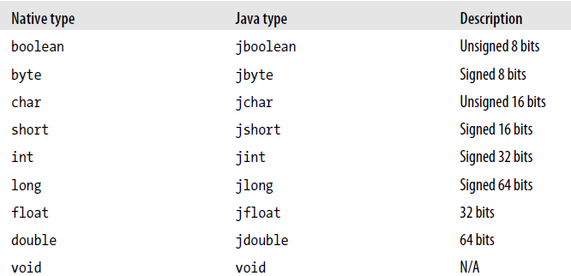
Data mapping

Slide 5
Android NDK
Android Native Development Kit (NDK) is a companion tool to the Android SDK.
If you use the NDK to create native code, your applications are still packaged into an .apk file and run inside a VM on the device.
The fundamental Android application model does not change.

Slide 6
Setting Up the NDK Environment
In order to use the NDK, you must first install and set up the SDK.
Operating System:-
Windows XP (32-bit) or Vista (32- or 64-bit) or later.
Mac OS X 10.4.8 or later
Linux (32- or 64-bit)
--------------------------------------------------------------------
First, download and install the NDK http://developer.android.com/sdk/ndk/index.html.

Slide 7
Compiling with the NDK
1. Create a jni directory within your project.
2. Place your native source in the jni directory.
3. Create an Android.mk file in the jni directory.
4. Run the ndk/ndk-build command from within the jni directory.

Slide 8
Native Libraries and Headers in Android
The NDK comes with the following set of headers for stable native APIs:-
libc (C library) headers
• libm (math library) headers
• JNI interface headers
• libz (compression library) headers
• liblog (Android logging) header
• OpenGL ES 1.1 and OpenGL ES 2.0 (3D graphics libraries) headers
• libjnigraphics (pixel buffer access) header (for Android 2.2 and later)
• A minimal set of headers for C++ support
• OpenSL ES native audio libraries
• Android native application APIs

